Slide 1
Guided by - Prof. Eduardo Chan
DATA 240 Project
Grocery Sales Forecasting
Team Members
Harshal Shah 017404166
Soujanya Sankathala 016878134
Riddhi Vyas 016801928

Slide 2
Project Background
Motivation
The retail industry faces significant challenges in inventory management and sales forecasting, due to constantly changing market conditions and customer behavior. The project is driven by the strong need to tackle these issues using strategies based on data driven analysis.
For Corporación Favorita, an inability to predict sales accurately results in either surplus inventory that ties up capital or stock outs that lead to missed sales opportunities and customer dissatisfaction. Optimizing this balance through improved forecasting can significantly enhance profitability and customer service.
Needs
Reliable daily sales forecasts to optimize inventory, reduce waste, and improve customer satisfaction.
Integration of diverse datasets (sales, promotions, holidays, oil prices) to capture external and seasonal influences on sales.
Advanced analytics and visualization tools to provide actionable insights for decision-making and strategic planning.

Slide 3
Target Problem & Deliverables
Target Problem & Objectives
Build a reliable sales forecasting system designed for Favorita’s range of products.
Include economic and seasonal factors to improve prediction accuracy.
Offer useful insights for managing inventory and planning promotions.
Deliverables
Improved sales forecasting accuracy with optimized predictive models with performance evaluations using metrics like RMSE and MAE.
A comprehensive project report & presentation slides detailing the methodology, findings, and recommendations for implementation

Slide 4
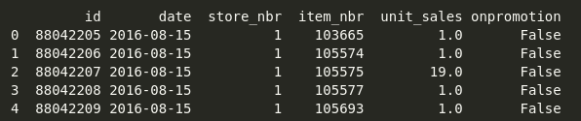
Data Collection & Engineering - Data Source
The dataset is provided by Corporación Favorita on Kaggle.
Dataset Link - https://www.kaggle.com/c/favorita-grocery-sales-forecasting/data
○ train.csv: Sales data by date, store, and item, with promotion details.
○ stores.csv, items.csv: Metadata for stores and items.
○ transactions.csv: Daily transaction counts per store.
○ oil.csv: Daily oil price information, as Ecuador’s economy heavily relies on oil.
○ holidays_events.csv: National holidays and events that may affect sales.
○ preprocessed_data.csv: Combined data from all files.
train.csv:
(12.5 million records)

Slide 5
Data Cleaning, Preprocessing & Transformation
From train.csv file, we'll use specific date range(1 year): start_date = '2016-08-15', end_date = '2017-08-15'
This file contains contains 3.7 million records.
From holidays_events.csv, we extracted records as per the date range we are using in train.csv and then we translated holiday_description column from spanish to english.
From items.csv, we have chosen 10 common grocery related product families:
"GROCERY I",
"BEVERAGES",
"CLEANING",
"PRODUCE",
"DAIRY",
"BREAD/BAKERY",
"LIQUOR,WINE,BEER",
"FROZEN FOODS",
"PREPARED FOODS",
"DELI".

Slide 6
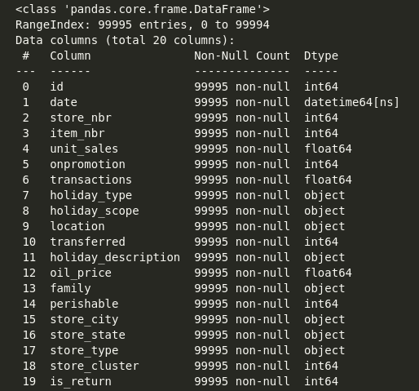
Then, we dropped missing features from all csvs and merged all into one.
Stratified Sampling by Family: A 100,000-record subset was created using stratified sampling on the product family column to ensure proportional representation of product categories, preserving diversity for robust trend analysis and initial modeling.

Slide 7
Feature Engineering
Temporal Features:
Extracted year, month, day of the week, week of the year, and is_weekend to capture seasonal trends, weekly patterns, and holiday effects.
Lag Features:
Created lag variables for unit sales and oil prices over the past 7 days:
unit_sales_lag_N: Tracks sales patterns over recent days.
oil_price_lag_N: Accounts for oil price trends, forward/backward filled for consistency.
Rolling Statistics:
Calculated mean and standard deviation of unit sales for the past 7 days:
rolling_sales_mean: Helps capture average sales trends.
rolling_sales_std: Captures fluctuations in sales for demand variability.
String Encoding:
Converted string columns (e.g., product categories) into numeric values using Label Encoding for model compatibility.

Slide 8
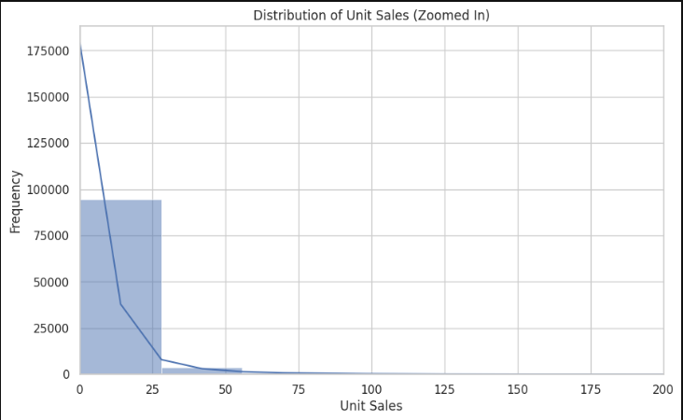
Exploratory Data Analysis (EDA)
Most items are sold in small quantities, usually less than 25 units, and the number of sales drops quickly as the quantity increases.

Slide 9
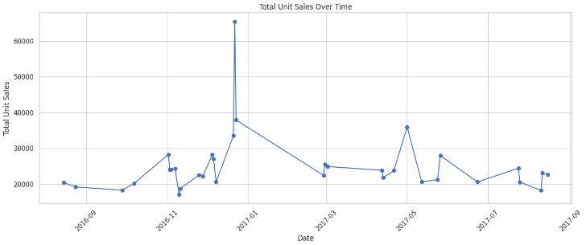
EDA - Distribution of unit_sales over time
The plot shows total unit sales over time, with a noticeable spike around January 2017, likely due to a special event or holiday. Sales fluctuate throughout the year, indicating seasonal trends or promotions affecting purchasing patterns.

Slide 10
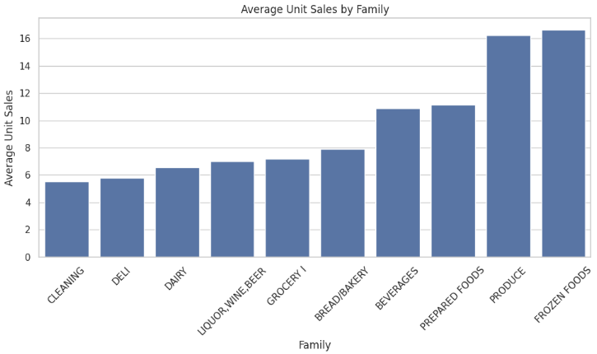
EDA - Distribution of unit_sales over product family
The plot shows the average unit sales across product families. Frozen Foods and Produce have the highest average sales, suggesting they are the most popular categories, while Cleaning and Deli have the lowest, indicating lower customer demand in these categories.

Slide 11
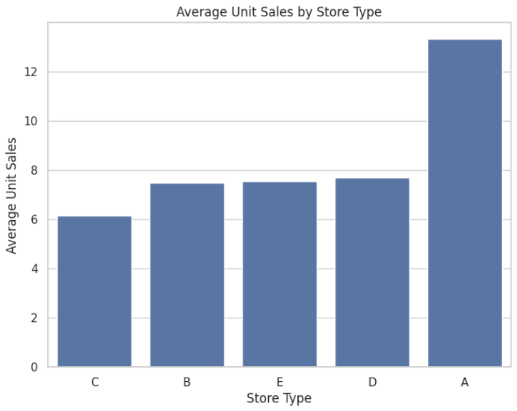
EDA - Distribution of unit_sales over Store Type
The plot shows the average unit sales across different store types. Store Type A has significantly higher average sales compared to other store types, indicating it likely serves a larger customer base or operates in high-demand areas. Store Type C has the lowest average sales, suggesting smaller customer reach or lower demand.

Slide 12
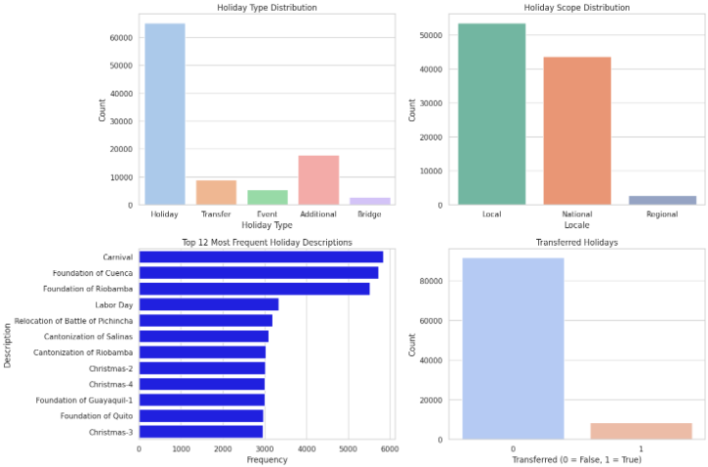
EDA - Holiday Distribution

Slide 13
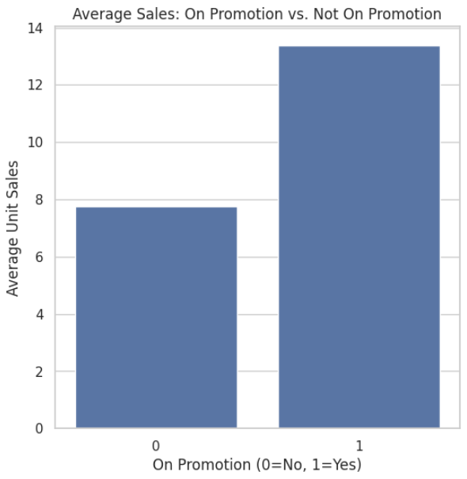
EDA - Promotion Impact on Sales
The plot shows that products on promotion have significantly higher average sales compared to those not on promotion.
This highlights the strong impact of promotions in driving customer purchases and boosting sales.

Slide 14
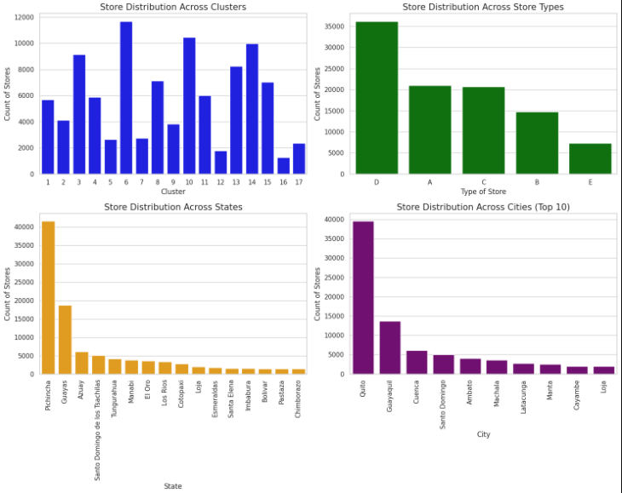
EDA - Store Distribution
The plot shows that products on promotion have significantly higher average sales compared to those not on promotion.
This highlights the strong impact of promotions in driving customer purchases and boosting sales.

Slide 15
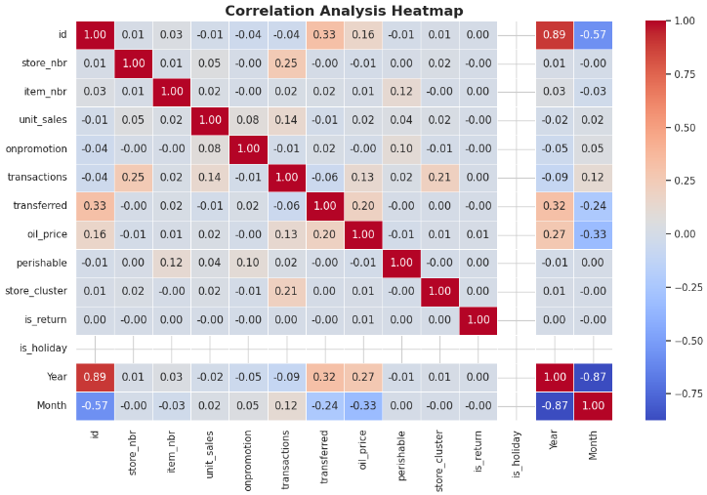
Correlation Analysis
The heatmap shows that transferred days are more like normal days than holidays, as they have a weak connection with holidays (-0.24).
However, promotions (0.32) often happen on transferred days, helping keep sales steady.
The key takeaway is that while transferred days don't behave like real holidays, smart use of promotions during these times can still boost sales.

Slide 16
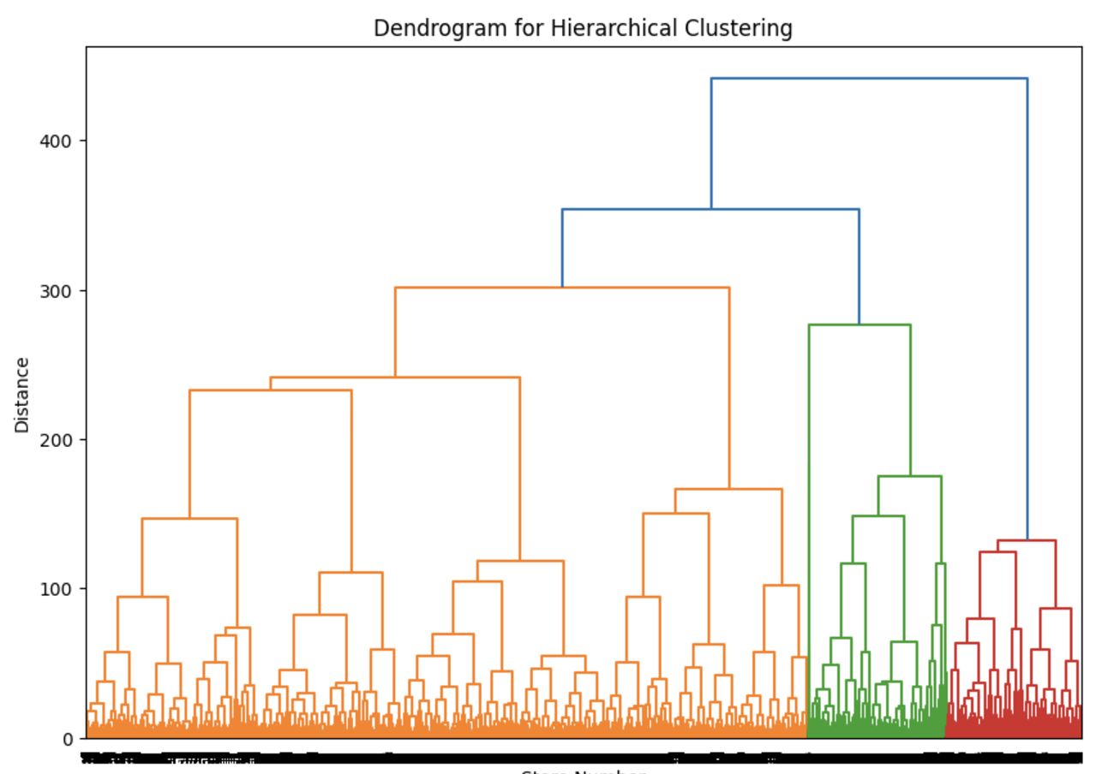
Data Mining Techniques
Clustering: Hierarchical Clustering and GMM were applied to the cleaned dataset to uncover patterns in store performance. This analysis identifies groups of stores with similar sales behaviors, promotional activities, and sensitivity to external factors, allowing for targeted business strategies.
Hierarchical clustering grouped stores based on operational and sales metrics like unit sales, transactions, promotions, and oil price sensitivity.
The resulting clusters provided a detailed view of store performance patterns, highlighting similarities and differences in their behaviors.
The Orange Cluster, representing the majority of stores, shows typical sales and transaction patterns, making them suitable for standardized strategies.

Slide 17
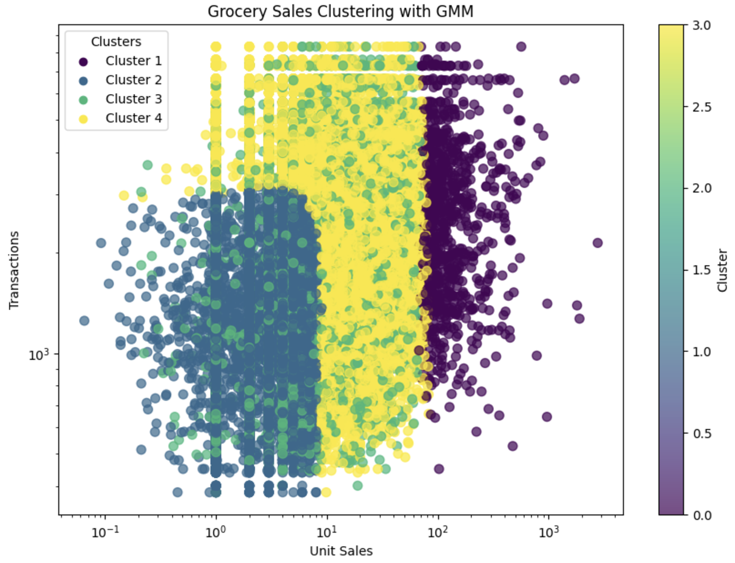
Gaussian Mixture Model
Gaussian Mixture Model (GMM) categorizes stores and items into distinct clusters based on their purchasing patterns using total unit sales and total transactions.
Cluster 1 Represents items with low unit sales but high transaction frequency, indicating frequent small purchases.
Cluster 2 : Represents a group of items with medium unit sales and medium transaction frequency. These items are typically bought in moderate quantities with average transaction counts.
Cluster 3 : Represents items with higher unit sales and moderate transaction frequency, indicating products that are purchased in larger quantities, but with fewer overall transactions.
Cluster 4 shows items with high unit sales but low transaction frequency, suggesting bulk purchases with fewer transactions.

Slide 18
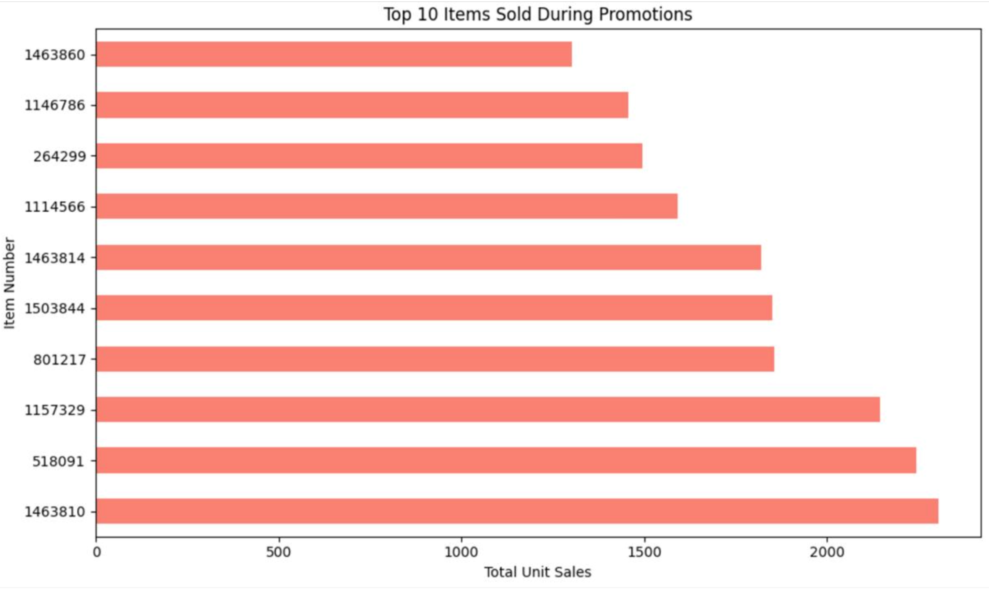
Pattern Mining
Identifying high-performing products during promotions, with a focus on understanding the sales patterns and their correlation to promotional strategies.
The top 10 items sold during promotions indicates that specific items consistently dominate in terms of total unit sales. Item numbers such as 1463860 and 1146786 emerge as particularly strong performers, with sales reaching well over 2000 units.
The top-selling items demonstrate clear patterns, suggesting that certain products are more attractive to customers when discounts or promotional offers are applied.
Focusing promotional efforts on these top-performing items can drive higher sales and profitability.

Slide 19
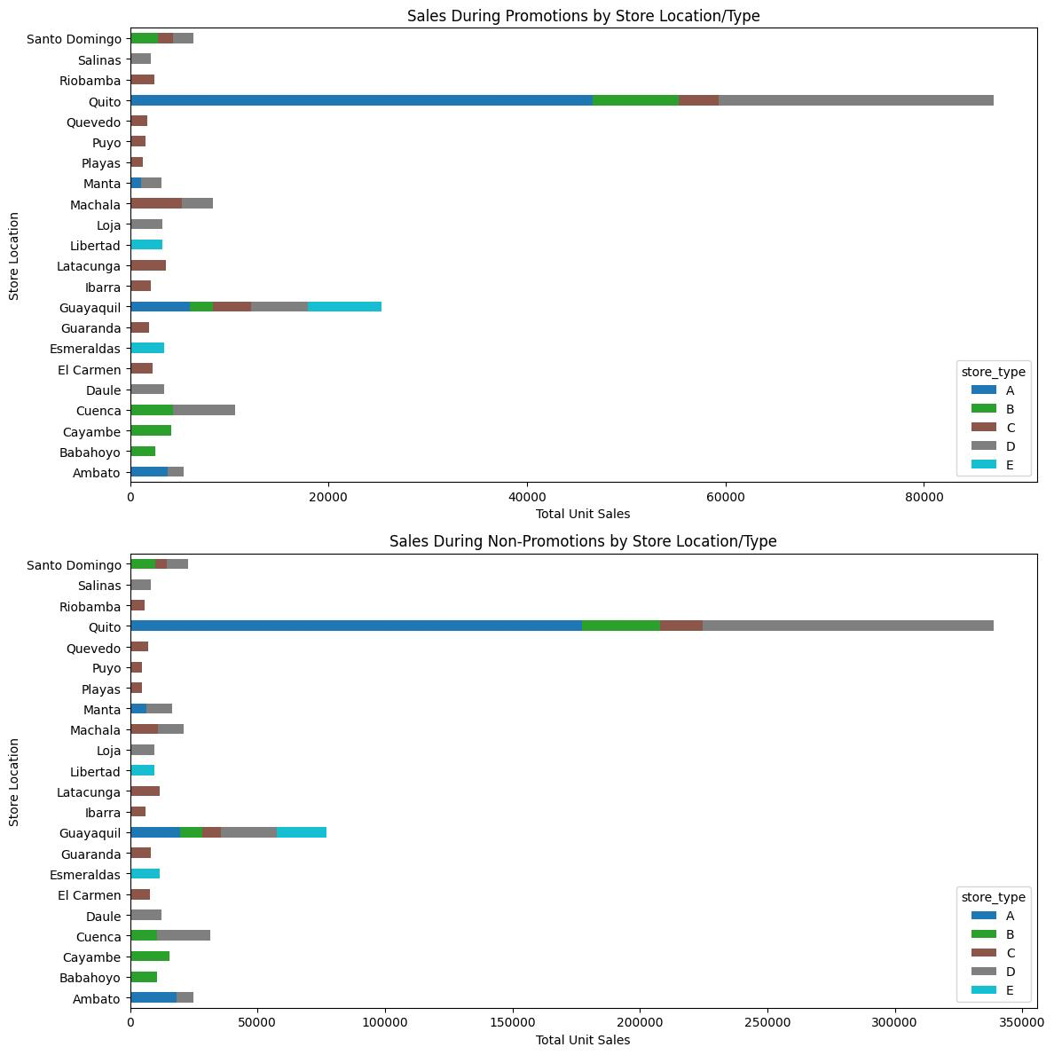
Pattern mining here identifies which store types perform best in terms of sales during both promotions and non-promotions. The analysis highlights that promotion effectiveness varies by location and store type.
Sales During Promotions : Quito stands out with the highest total unit sales during promotional periods and Store Type A dominates sales during promotions, suggesting its strong performance across locations.
Sales During Non-Promotions : Non-promotion sales are much higher overall, with Quito and Guayaquil again leading by a significant margin.
Quito and Guayaquil drive the majority of sales, regardless of promotions.
Promotions significantly boost sales but are concentrated in fewer locations and store types, especially Store Type A.
Non-promotion sales contribute more overall, showing a steady demand outside promotional periods.

Slide 20
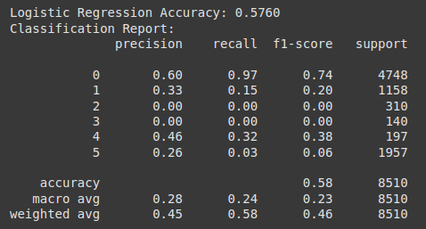
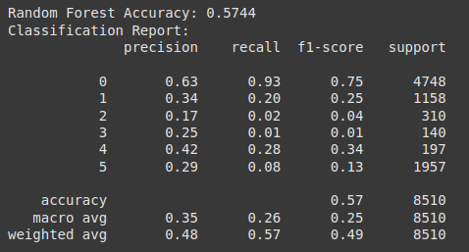
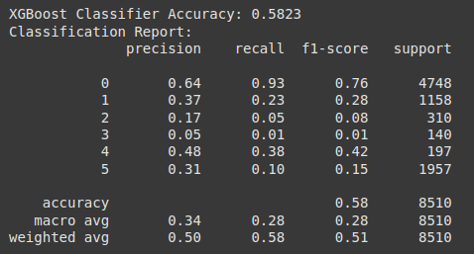
Predictive Modeling (Classification case)
Classification: Classify items into sales buckets to analyze demand patterns during promotions and holidays. Sales buckets (6 classes) : (0-4), (5-9), (10-19), (20-29), (30-39), (40+)

Slide 21
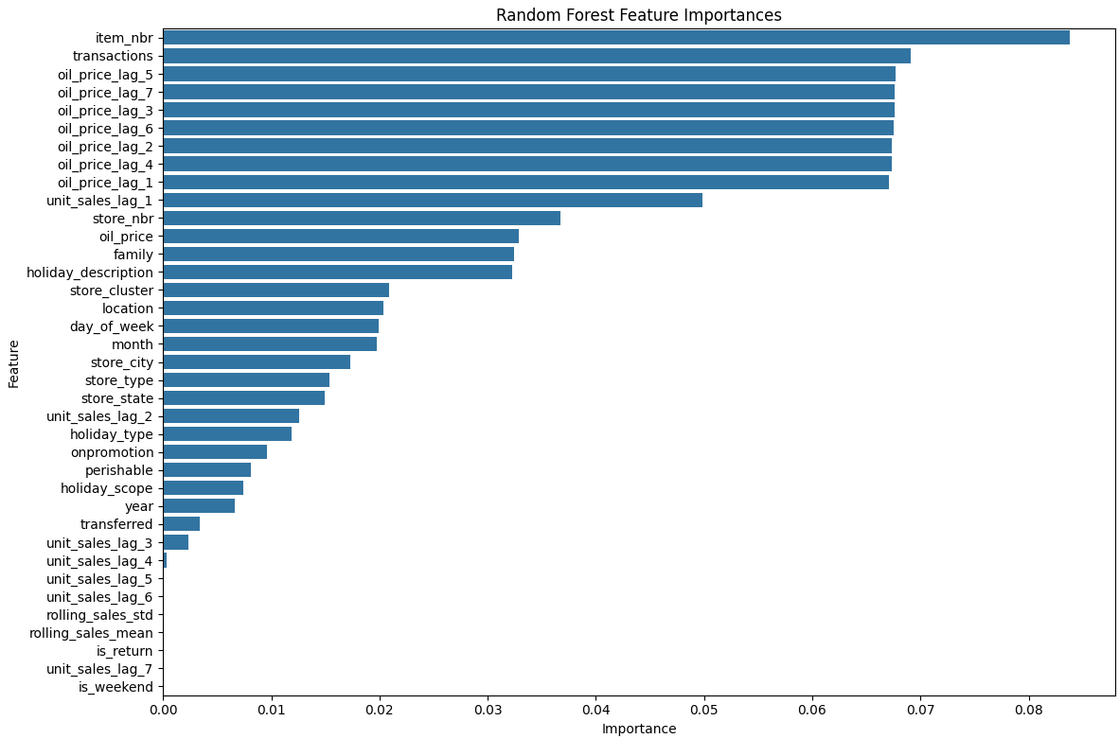
Random Forest Feature Importances
The feature importance plot shows that item number, transactions, and oil price lag features are the most important for predicting sales, while temporal and holiday-related features have relatively less influence. This highlights the significance of product-specific and economic factors in driving sales patterns.

Slide 22
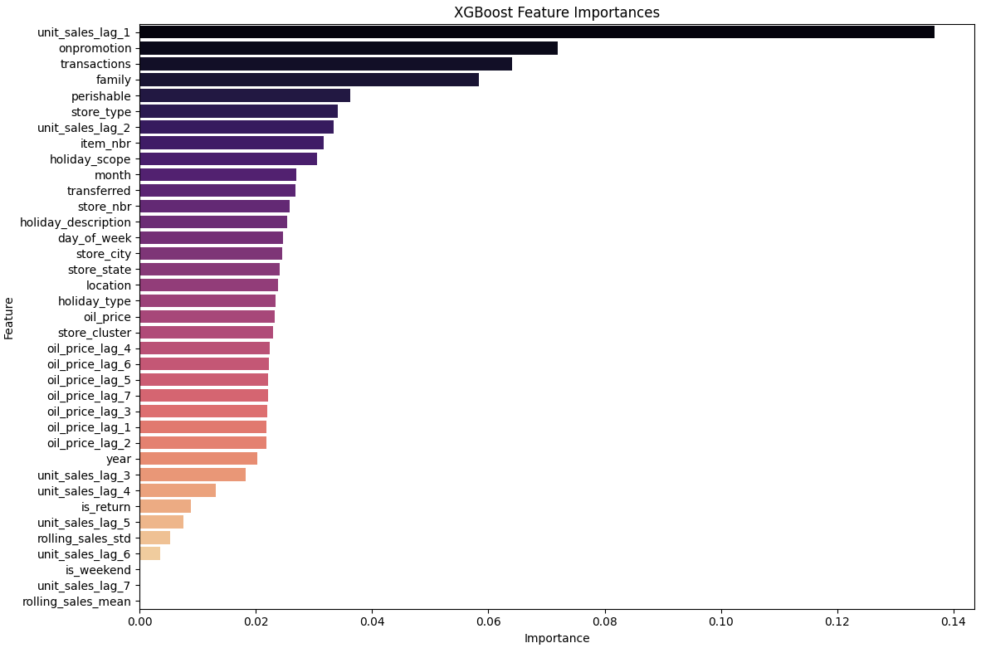
XGBoost Feature Importances
The feature importance plot shows that recent sales (unit_sales_lag_1) and promotions (onpromotion) are the strongest predictors of future sales, followed by transactions and product family. An impressive insight is that promotions significantly impact sales, highlighting their role in driving demand more effectively than even long-term historical trends or economic indicators like oil prices.

Slide 23
AutoGluon for Sales Classification (Model Tuning and Eval)
Enhance classification performance by leveraging AutoGluon framework, an automated machine learning library, on top of traditional models for hyper parameter tuning and experimenting various model configurations.
Results Comparison:
Traditional Models (Manual Implementation): Best Accuracy: 58.23%, F1: 0.76 (XGBoost Classifier)
AutoGluon (Automated): Best Accuracy: 60.09%, F1: 0.8 (NeuralNetFastAI with Ensemble)
Model Overview:
Name: NeuralNetFastAI_BAG_L2
Description: A deep learning-based model trained with FastAI, optimized for classification tasks with bagging for enhanced performance.
Hyperparameters:
Learning Rate: 0.01
Dropout: 0.1
Early Stopping: Patience of 20 epochs
Bagging: Combines multiple NeuralNetFastAI models to reduce overfitting and improve generalization.
Feature Importance: unit_sales_lag (recent sales trends), onpromotion (impact of promotions), transactions (customer activity), family (product categories)

Slide 24
Predictive Modeling (Regression Case)
Model Development, and Eval
The overall dataset was for ~1 year, we split the test set to keep the last two months, and also ensuring all items and stores in the test set are represented in the training set for unit sales forecasting.
Model | Test MSE | Test MAE | Pearson Correlation | R²
Random Forest | 102.03 | 4.2589 | 0.72 | 0.52
LightGBM | 116.48 | 4.2534 | 0.69 | 0.47
XGBoost | 121.78 | 4.27 | 0.65 | 0.42
KNN | 178.39 | 5.30 | 0.30 | 0.09
Test sample : 8.5k, Train samples: ~92k. Random Forest showcase the best performance.
Results Remarks:
It is important to note that the units sales range from 0-500, thus the high MSE but the Pearson correlation with prediction and target shows the model is positively correlated with the sales prediction.

Slide 25
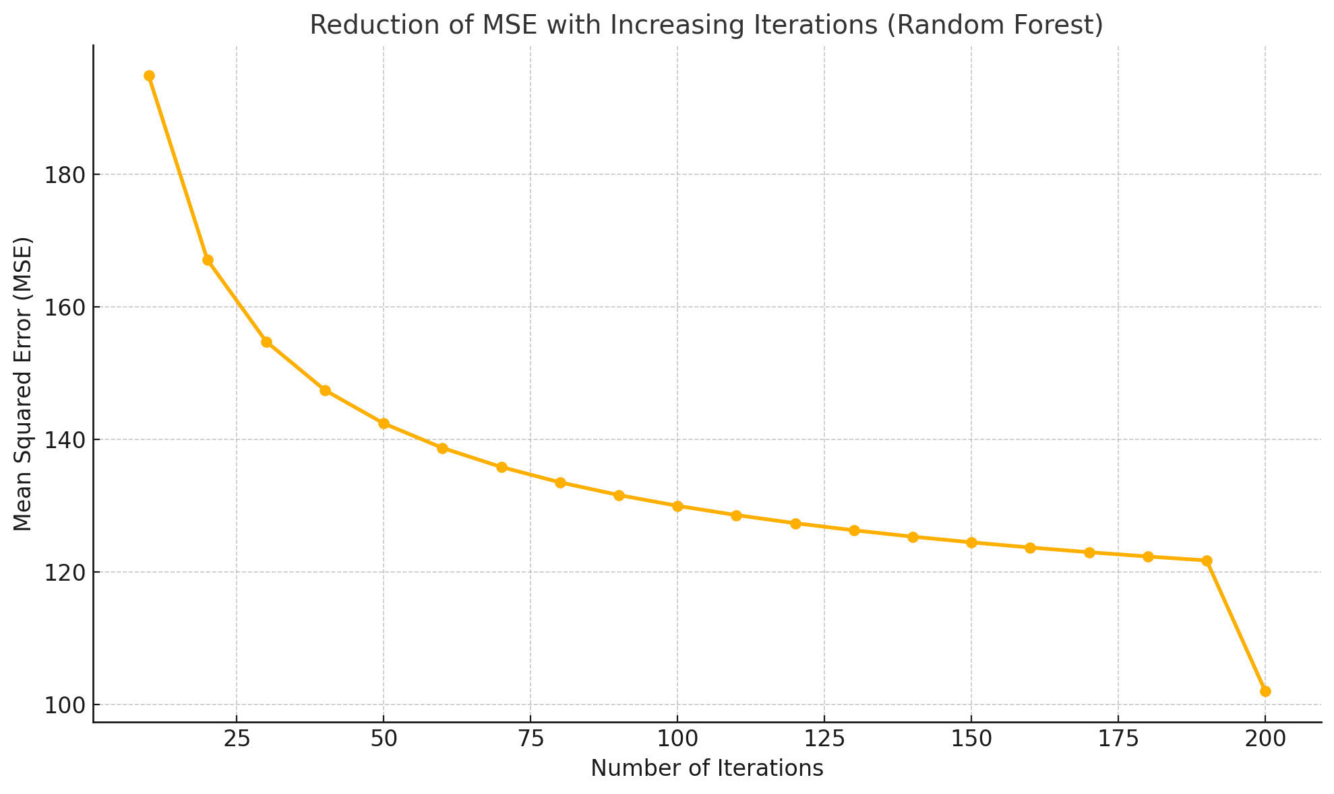
Predictive Modeling (Regression Case)
Model Development, and Eval

Slide 26
Results & Conclusion
We have successfully build both predictive and classification models to effectively forecast the unit sales per store and item level.
Our results demonstrates promising directions
Best Predictive model shows : 4.25 MAE and 0.72 Pearson correlation with unit sales
Best Classification model shows 60% accuracy and 0.80 F1 (baseline accuracy 16%)
The integration of economic indicators, seasonal factors, and promotional effects enhances the predictive capabilities, providing actionable insights that align with business objectives. Furthermore, the development of an interactive dashboard ensures that stakeholders have access to real-time forecasts and trends, improving decision-making efficiency.
Overall, this project not only demonstrates the potential of data-driven forecasting to reduce costs and improve operational efficiency but also lays the groundwork for future enhancements in predictive analytics for retail.

Slide 27
THANK YOU!

